Slide 1
Section 12.6
Systems of Nonlinear Equations
Copyright © 2012 Pearson Education, Inc. Publishing as Prentice Hall.

Slide 2
Copyright © 2012 Pearson Education, Inc. Publishing as Prentice Hall.

Slide 3
If the system contains two variables and if the equations in the system are easy to graph, then graph them. By graphing each equation in the system, you can get an idea of how many solutions a system has and approximately where they are located.
Extraneous solutions can creep in when solving nonlinear systems, so it is imperative that all apparent solutions be checked.
Copyright © 2012 Pearson Education, Inc. Publishing as Prentice Hall.

Slide 4

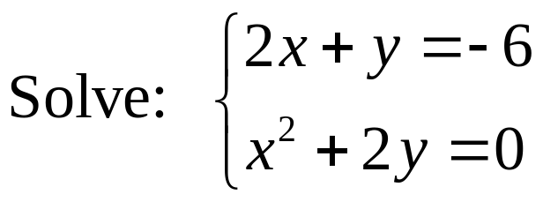


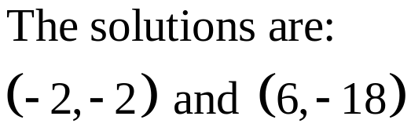
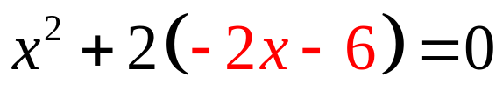
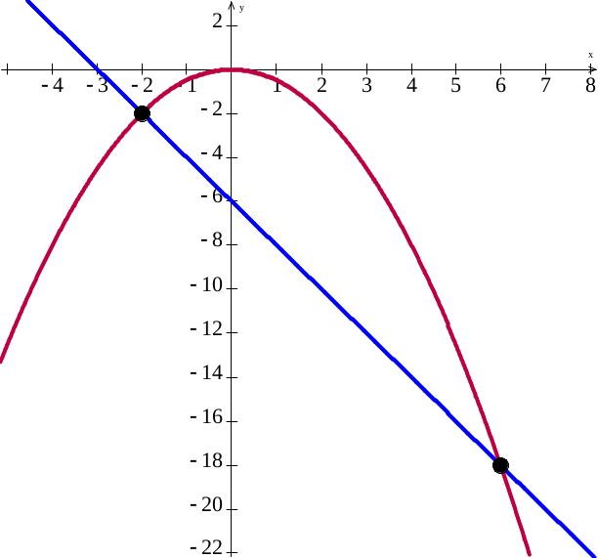







First let’s look at the graph. The first equation is a line with x intercept –6 and y intercept – 4. The second a parabola opening down.
Solve first equation for y
Copyright © 2012 Pearson Education, Inc. Publishing as Prentice Hall.

Slide 5
Copyright © 2012 Pearson Education, Inc. Publishing as Prentice Hall.

Slide 6
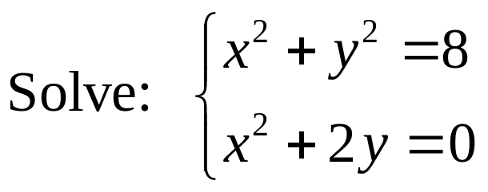
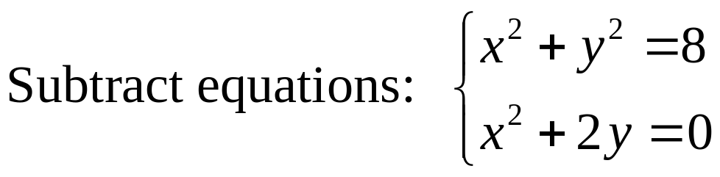
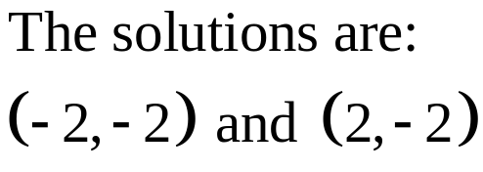
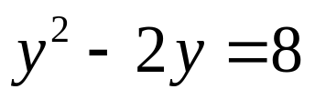
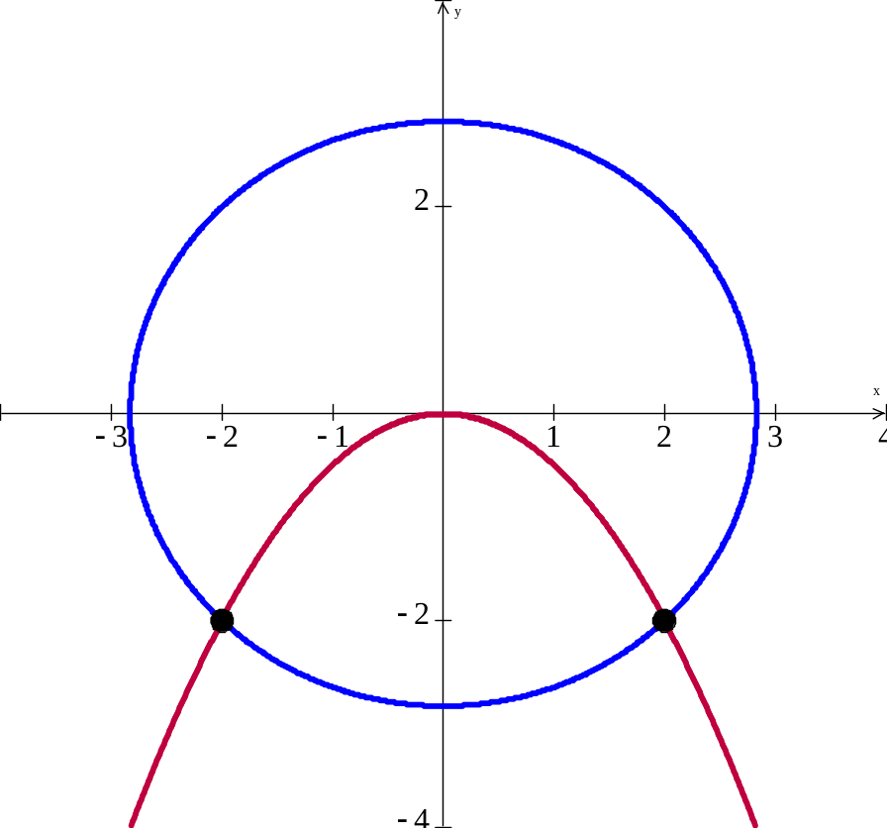
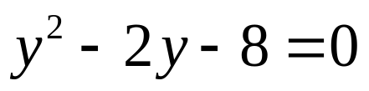
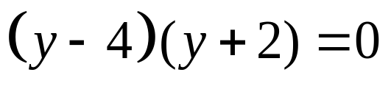

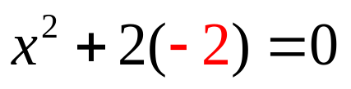


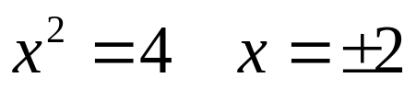
Copyright © 2012 Pearson Education, Inc. Publishing as Prentice Hall.

Slide 7
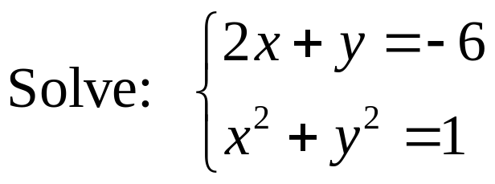
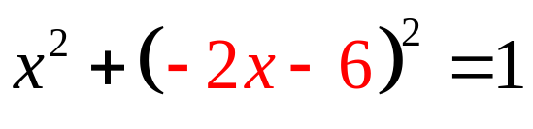
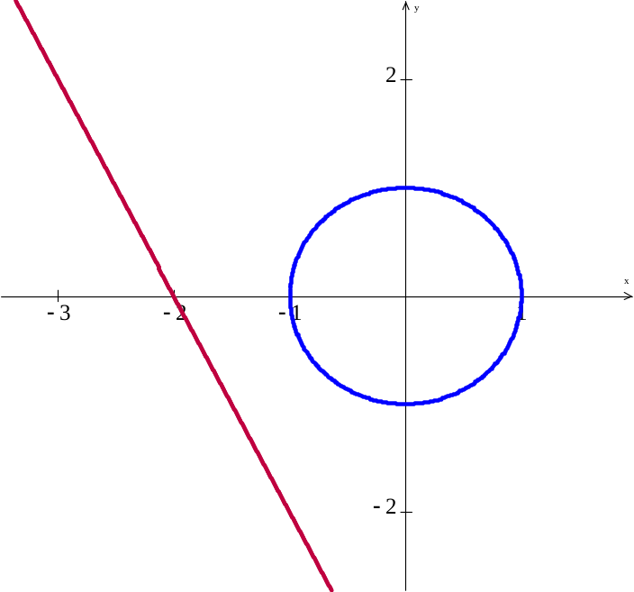


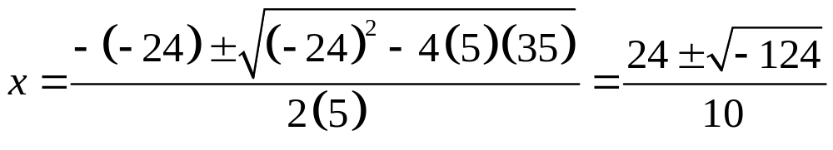
Looking at the graph, it appears there are no solutions but we’ll confirm this with the algebra.
The system is inconsistent and has no real solution.
Copyright © 2012 Pearson Education, Inc. Publishing as Prentice Hall.

Slide 8
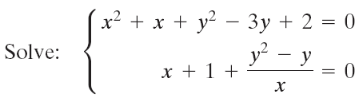

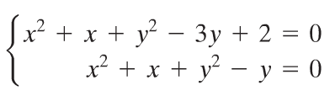
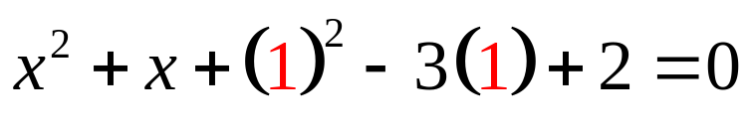

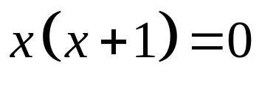



The solution is (–1, 1)
Copyright © 2012 Pearson Education, Inc. Publishing as Prentice Hall.

Slide 9



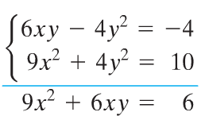

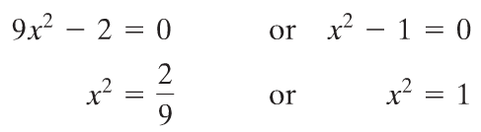




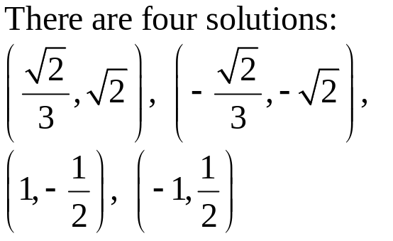

Copyright © 2012 Pearson Education, Inc. Publishing as Prentice Hall.

Slide 10
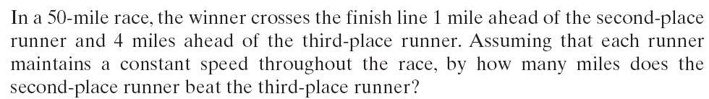
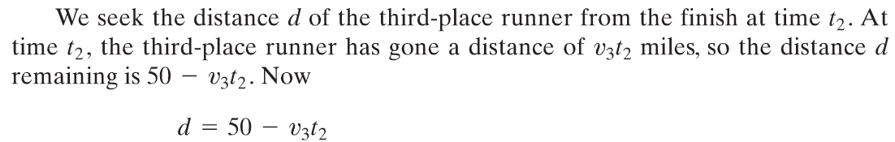
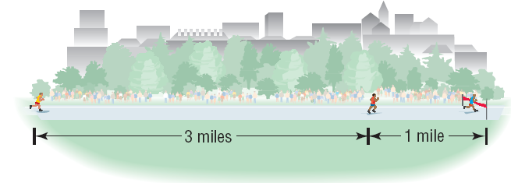
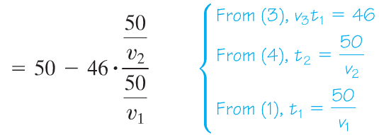
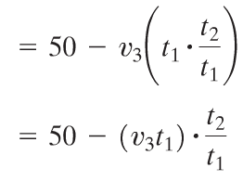
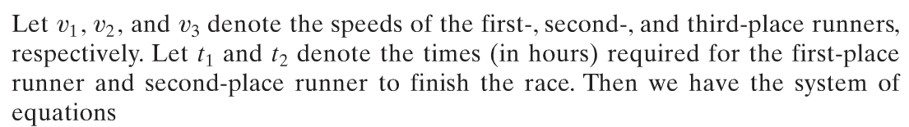


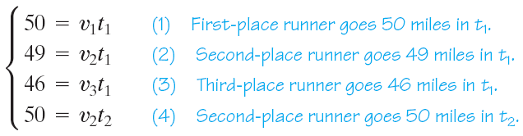
Copyright © 2012 Pearson Education, Inc. Publishing as Prentice Hall.

